Slide 1
ELCT 222 Final Project:
Sound Visualizer
Team Members:
Rithvik Oruganti
Anthony Perre
Anirudh Oruganti
Hudson Hok

Slide 2
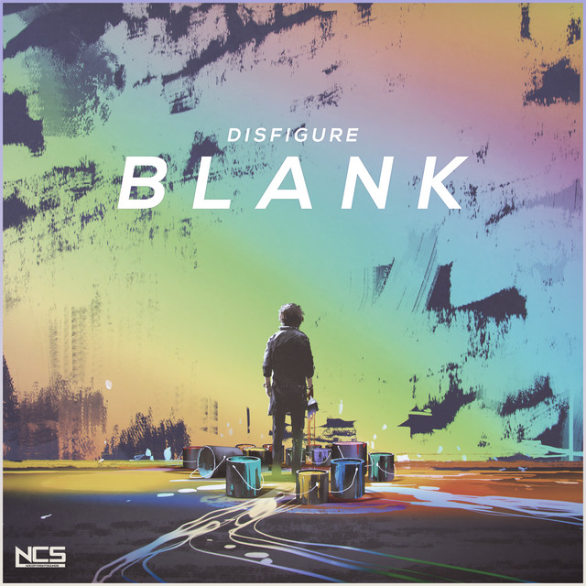
Introduction
Selected the song “Blank” by Disfigure because it contains a noticeable bass drop 30 seconds into the song.
Utilized a scatter plot and polar plot to give a visual representation of the music
Highlighted the bass by modifying the data used for the polar plot.
Customized the polar plot and scatter plot; additionally, created UI which allowed the user to stop the music or exit the program.

Slide 3
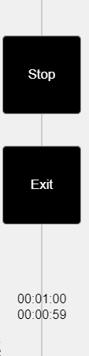
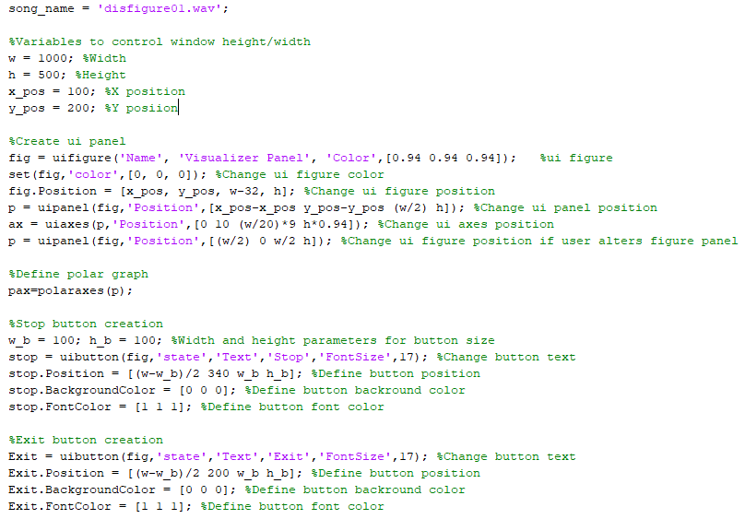
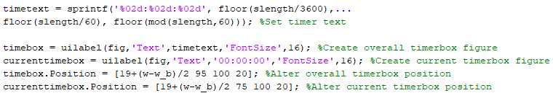
Methodology Pt1.
Creation of UI objects such as the window and the buttons.
Buttons are used to stop the music or exit out of the window.
Creation of a two timer objects, they indicate playable time and playing time.
UI objects are set at a static position.
Color for buttons were set to black while having white text to match the polar and scatter plots.

Slide 4
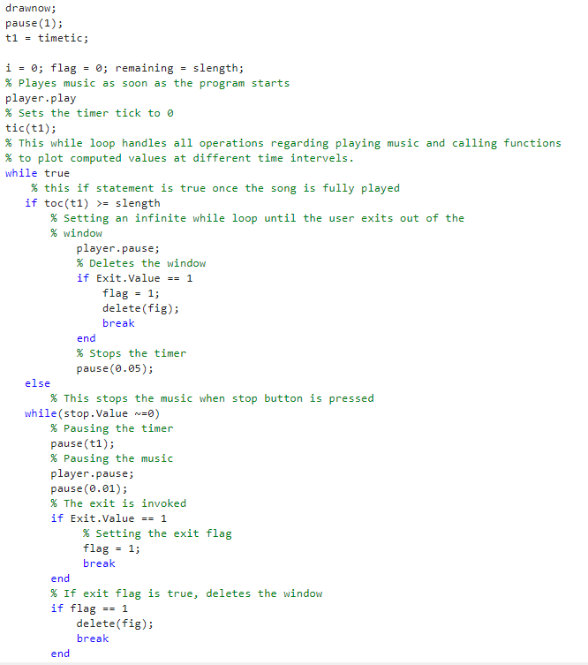
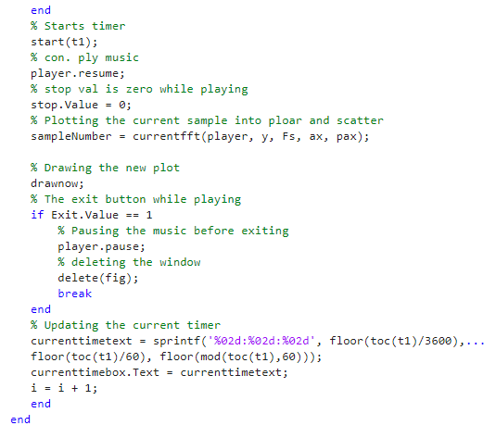
Methodology Pt2.
The code block to the right contains required logic with UI inputs while the music is played
Stop and exit buttons.
Checks for the input during every iteration of the loop
The timer gets updated and changed during every iteration of the loop.
A function is being called to plot power and transformation on polar and scatter plots for each sample

Slide 5
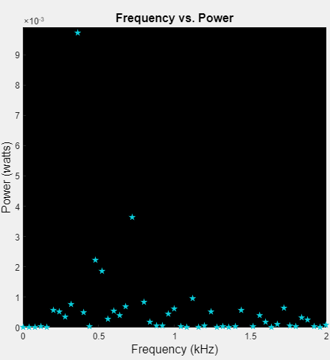
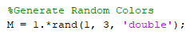
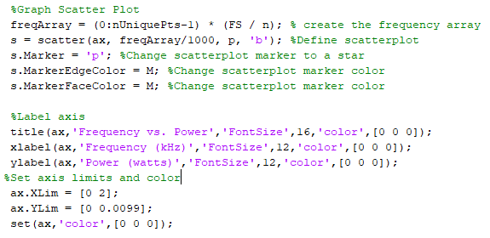
Methodology Pt3.
Created a scatterplot depicting the relationship between frequency and power.
Customized axis titles, units, color, etc.
Randomized color of data points to stylize the scatterplot; additionally, used stars to represent data points
Relevant code sections and image of scatterplot can be seen to the right.

Slide 6
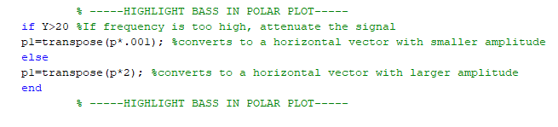
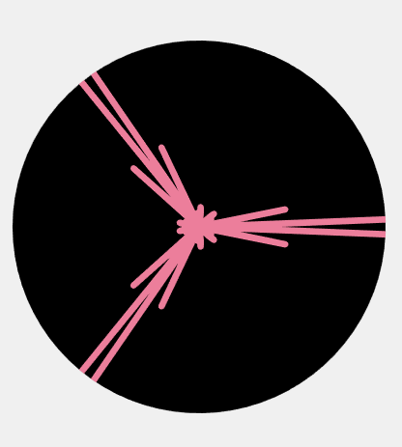
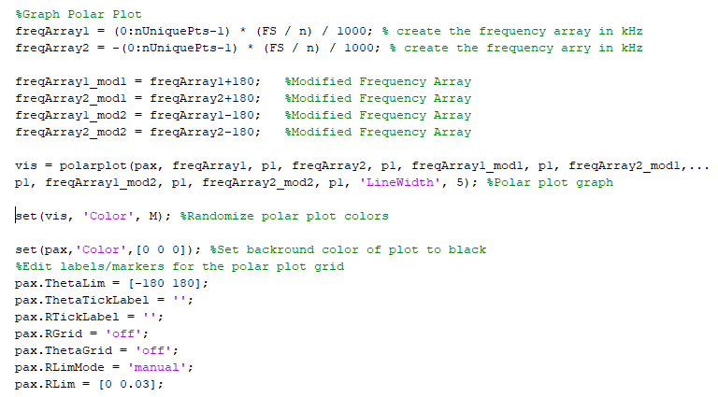
Methodology Pt4.
Polar plot gives visual depiction of the song by associating power values with vector lengths.
Bass highlighted in the polar plot visualizer by lowering vector lengths for higher frequencies.
Utilized several frequency arrays to enhance plot visuals.
Used color randomizer shown in the previous slide to change the color of the vectors.
Customized the plot by removing grids and labels; additionally, set the background of the plot to black.

Slide 7
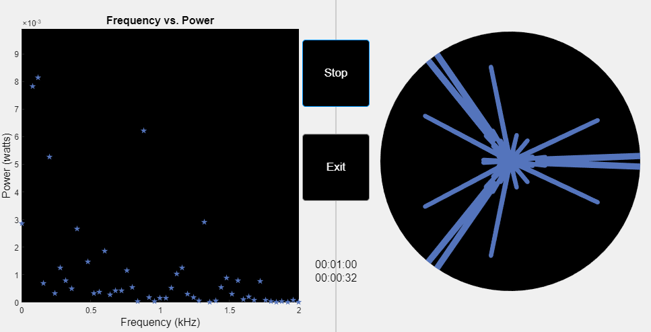
Results
Image to the right shows the output of the program.
Combines code subsystems examined in previous slides.
Noticeable change in the polar plot around 30 seconds (highlighted heavy bass)
Visualizer is functional; however, there are noticeable performance drops due to intense CPU/GPU usage
Power usage for each sample of the song is as follows:
Max: 8.93e-2 W
Min: 3.8e-07 W
Mean: 1.7e-3 W

Slide 8
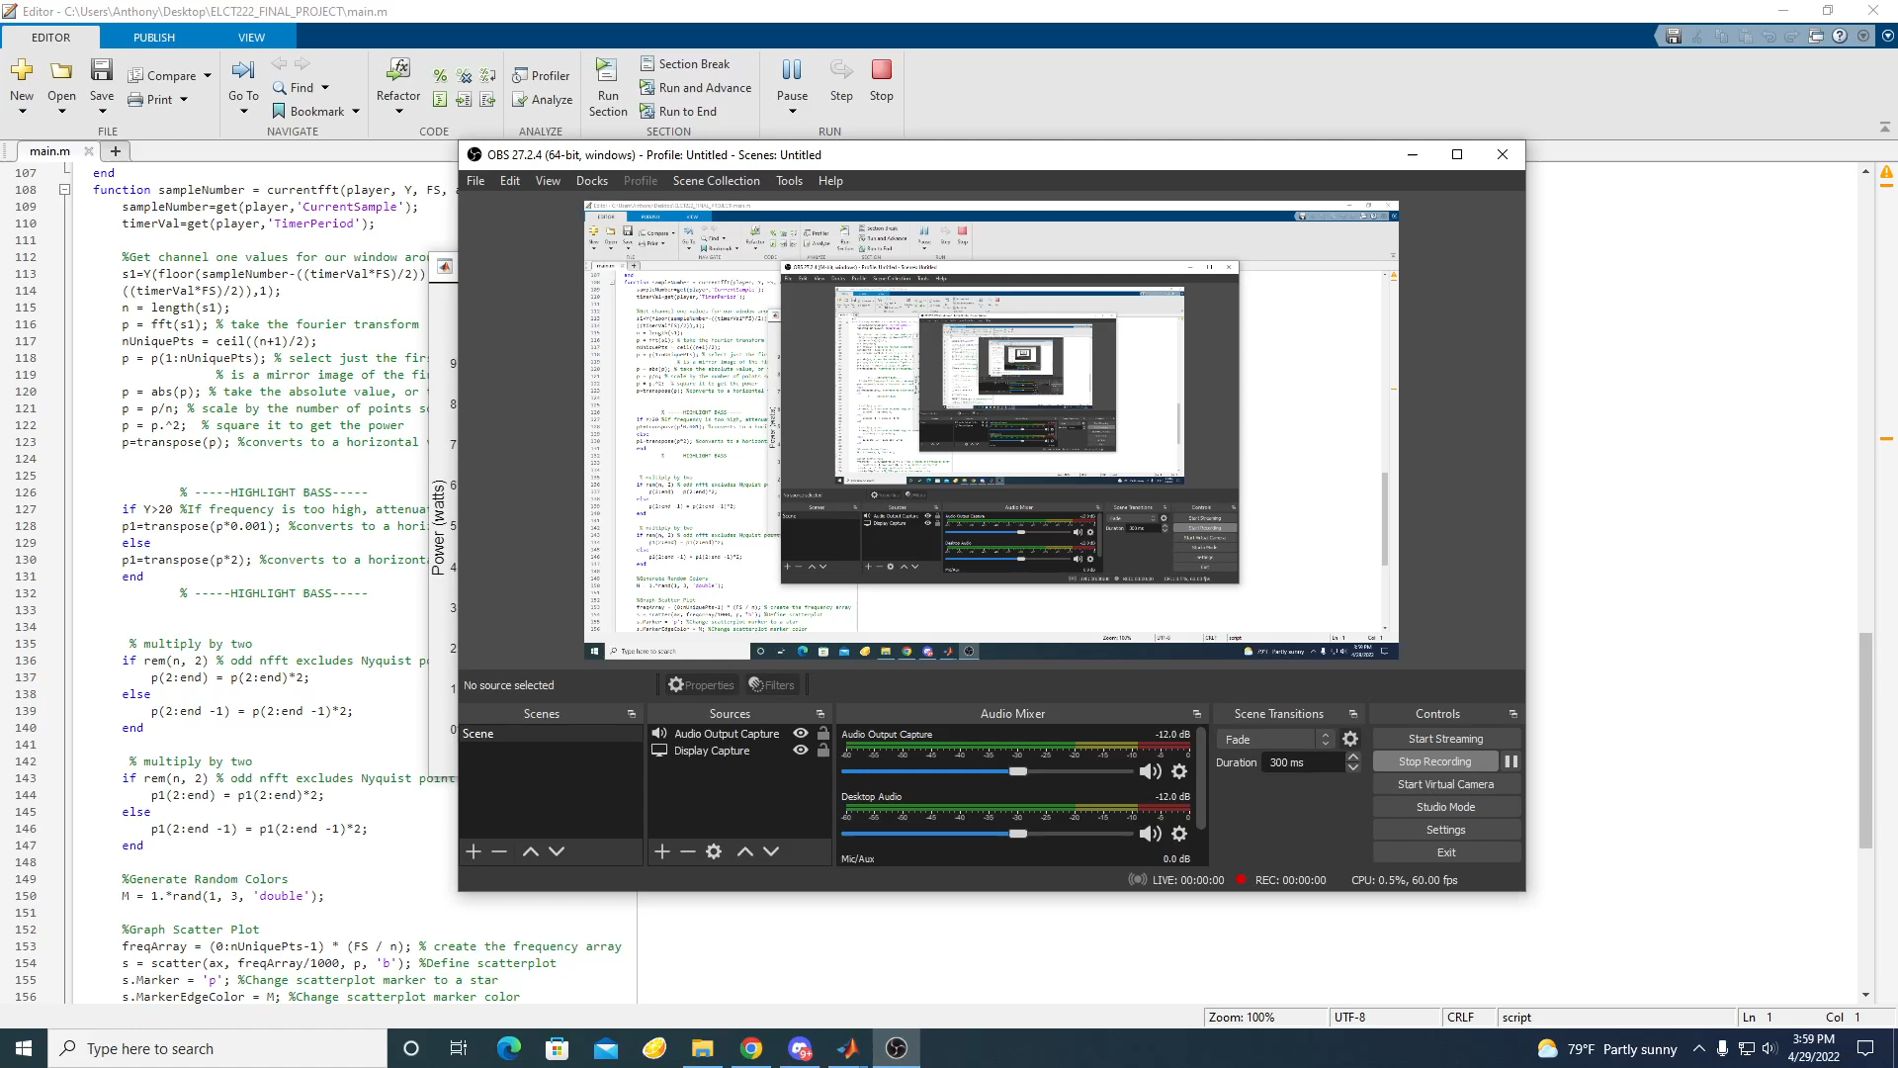
Sample Demo

Slide 9
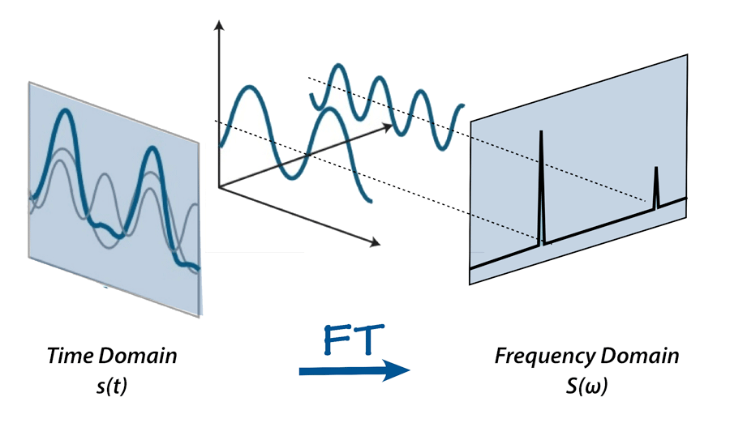
Conclusion
Successfully implemented an audio visualizer for the song “Blank”
Useful experience for relating time and frequency domain; additionally showed the importance of the Fourier transform and how it is utilized in common applications
Application of the Fourier transform in the context of this project includes decomposing an audio sample into its spectral components and displaying them in a visually appealing manner.

Slide 10
Credit
Anthony: 25%
Rithvik: 25%
Anirudh: 25%
Hudson: 25%

